Slide 1
NYC Open Dining Program
Exploratory Data Analysis
Hyejin Kim

Slide 2
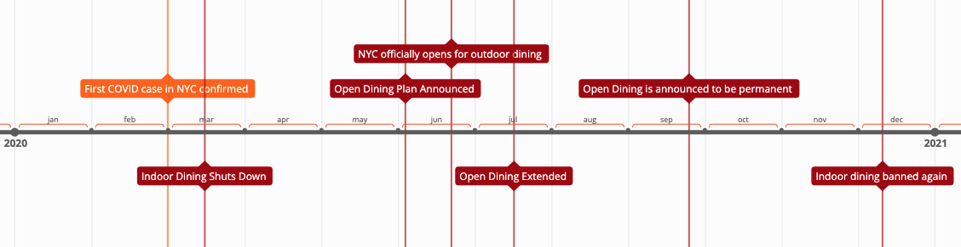
Background
Notes:
https://ny.eater.com/2020/12/30/22203053/nyc-coronavirus-timeline-restaurants-bars-2020

Slide 3
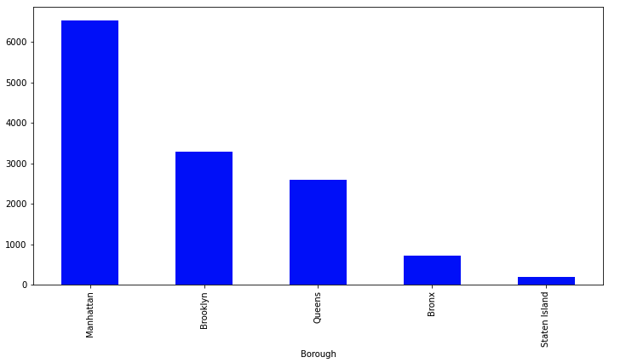
Background
Number of restaurants that have applied for the open dining program
Notes:
Over 12k restaurants have applied and have been approved for outdoor sidewalk and or road dining since the start of the program
total num of restaurants that applied for open dining by borough

Slide 4
Questions
How has the increase of restaurants taking up additional street and road space affected NYC resident quality of living?
Explore NYC 311 Complaints focused in the areas pertaining to:
Outdoor Noise
Dirty Conditions
Illegal Parking
Data:
Open Dining Application (~13k)
311 Complaints (~28m / ~880k)

Slide 5
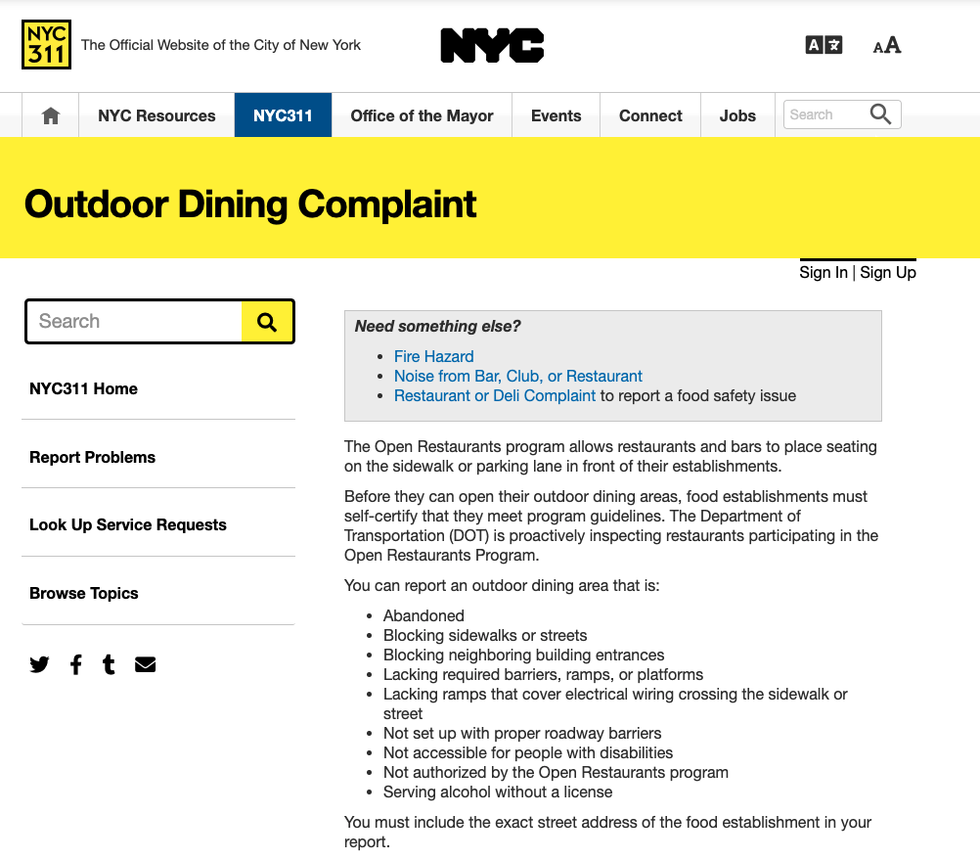


Slide 6
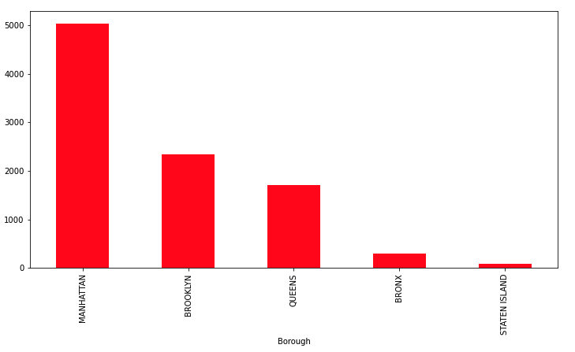
Number of open dining complaints reported

Slide 7
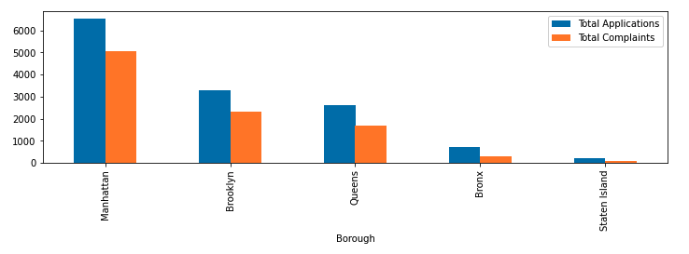
Comparing volume of open dining restaurants to volume of complaints

Slide 8
Complaint Description | % Total
Sidewalk Zone Blocked | 39.6%
Site Setup Condition | 31.5%
Barrier Condition | 11.5%
Street Zone Blocked | 11.1%
Unauthorized Restaurant | 3.3%
Table Not in Compliance | 2.7%
ADA Ramp Missing | 0.3%
Utility Cover Blocked | 0.1%
Platform Condition | 0.0%
Resolution | % Total
Not in compliance | 40%
In compliance | 33%
Misc | 23%
Not authorized | 2%
Referred to another agency | 2%

Slide 9
Related Complaints
Dirty Conditions
Improper disposal/Dumping
Dirty sidewalk, Trash, Spillage
Rodents/Insects
Illegal Parking
Blocked Driveway/Bike Lane/Hydrant
Double Parking
Parking Sign Violation
Outdoor Noise (commercial & street)
Loud Music/Party
Loud Talking

Slide 10
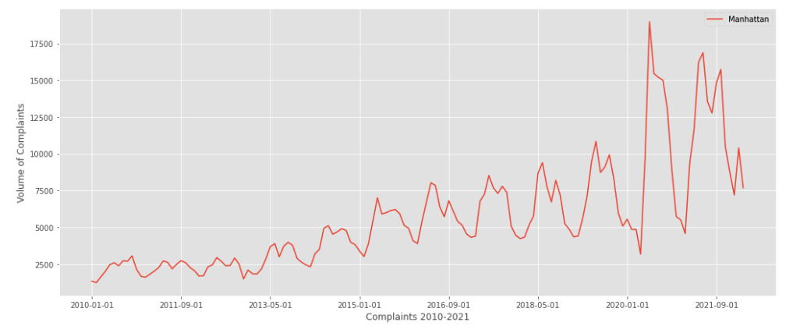
Complaints in Manhattan (2010-2022)

Slide 11
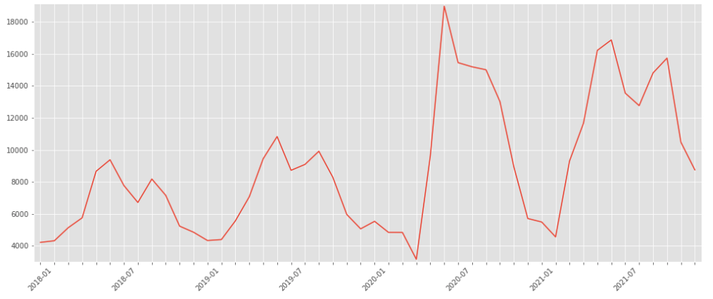
Closer look
Restaurants Close
Stay at home orders begin
Open Dining Announced

Slide 12
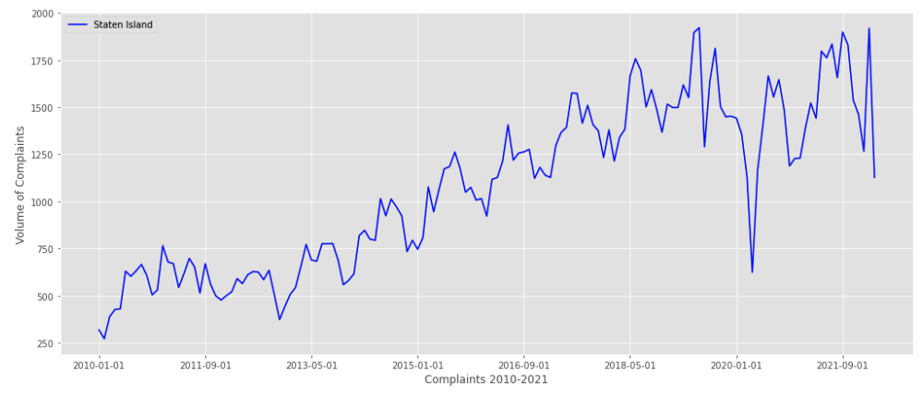
Comparing trend of the 3 complaints
Manhattan (High vol of OD)
V.
Staten Island (Low vol of OD)

Slide 13
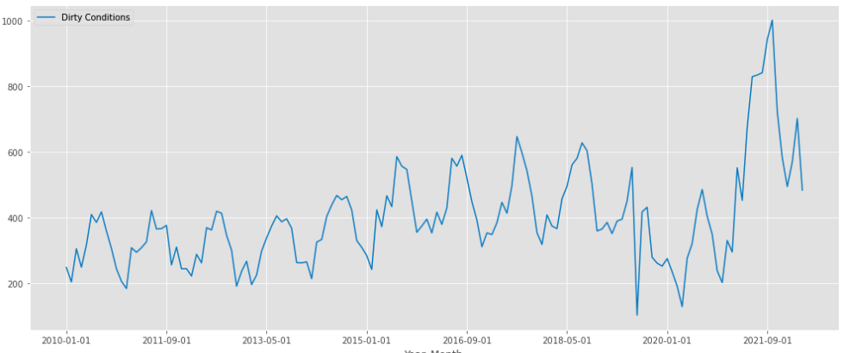
Dirty Condition Complaints (Manhattan 2010 - to date)

Slide 14
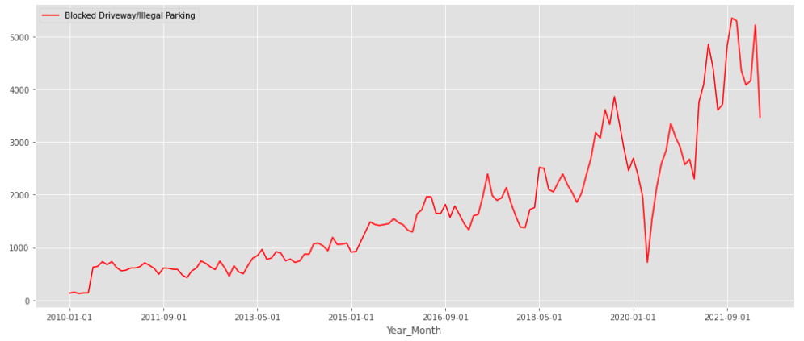
Illegal Parking Complaints (Manhattan 2010 - to date)

Slide 15
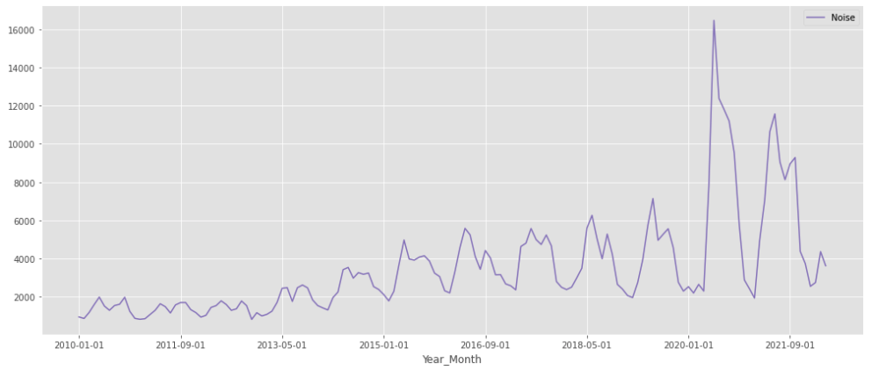
Outdoor Complaints (Manhattan 2010 - to date)

Slide 16
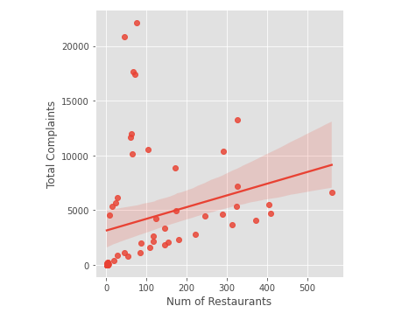
Complaints & OD Density by Zip Code
Relationship between OD Density and volume of complaints
Outliers were all in the same general area

Slide 17
Takeaways & Next Step
Most significant impact was noise
Explore impact to traffic

